Slide 1

UNIT 4
LEARNING
A FOREIGN LANGUAGE
LISTEN - WRITE

Slide 2


NGA
KATE

Slide 3


New words
VERB:
- improve/ɪmˈpruːv/: cải thiện
→ improvement /ɪmˈpruːvmənt/ (n): sự cải thiện
NOUN:
- skill /skɪl/: kĩ năng
4

Slide 4
TRUE or FALSE ?
T
a. Nga’s studying English for her work.
b. She learned English at school and university.
T
c. She works for a national bank in Ha Noi.
F
→ She works for an international bank in Ha Noi.

Slide 5
TRUE or FALSE ?
d. She needs to improve her writing.
T
e. Her listening is excellent.
F
→ Her listening is terrible.
f. She hopes she can talk to people from all over the world, and understand her favorite English songs.
T

Slide 6
Listen and complete the dialogue:
Host : Kate, can I introduce you to Nga ? She’s studying English here in London.
Kate : Hello, pleased to meet you.
Nga : Pleased to meet you, too.
Kate : (1)……….. are you from, Nga?
Nga : I’m from Vietnam.
Kate : Why are you studying English here ?
Nga : I need it for my (2)……..
Kate : Really? So, what do you do?
Nga : I work for a bank, an (3)…………………bank in Hanoi.
Kate : Oh, I see. Did you learn English at school?
Nga : Yes, and at university, too. But I’ve forget …er … forget…
Kate : Forgotten.
Nga : Yes, of course. I’ve forgotten a lot of it. I want to (4)…………… my writing
skill. You know…. sometimes I have to write letters in English.
Kate : What about listening, Nga ?
Nga : It’s (5)……………. This is my biggest problem. People talk very (6)…………...
and I can’t understand them.
Kate : Do you like studying English ?
Nga : Oh, yes. It’s an interesting language and it’s very (7)…………; and I can talk to people from all over the world…and I can understand the (8)…………of my favorite songs, too.
Kate : Well. That’s very good. Good luck to you, Nga.
Where
job
international
improve
terrible
quickly
useful
words

Slide 7


Unit 4:
LEARNING A FOREIGN LANGUAGE
Lesson : WRITE

Slide 8


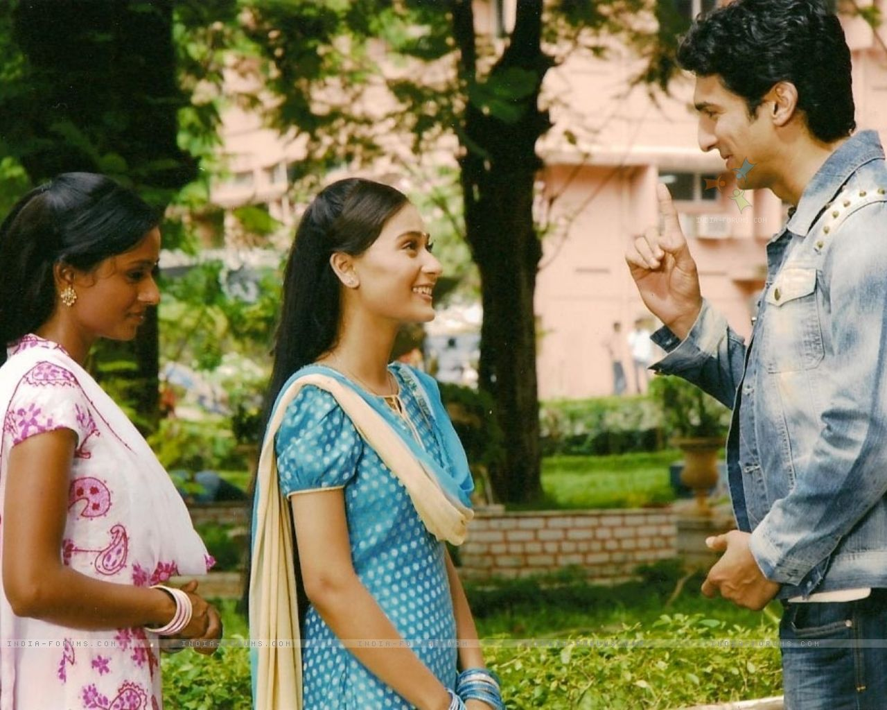
- He’s from the USA.
Can he speak and read Vietnamese?
- He works in HCM City.
- He likes learning Vietnamese
x
read

speak
John Robinson

Slide 9
a) Read Mr. Robinson’s letter.
A letter of inquiry

Slide 10
1/ Vocabulary:
- inquiry /ɪnˈkwaɪəri/(n):
sự tham vấn, hỏi thăm
- request /rɪˈkwest/(n):
lời yêu cầu
- edition /ɪˈdɪʃn/(n):
bản in, lần xuất bản
- detail /ˈdiːteɪl/ /dɪˈteɪl/(n):
chi tiết
- fee /fiː/(n):
học phí
- look forward to + V- ing
mong đợi
Ex: I am looking forward to hearing from you.

Slide 11
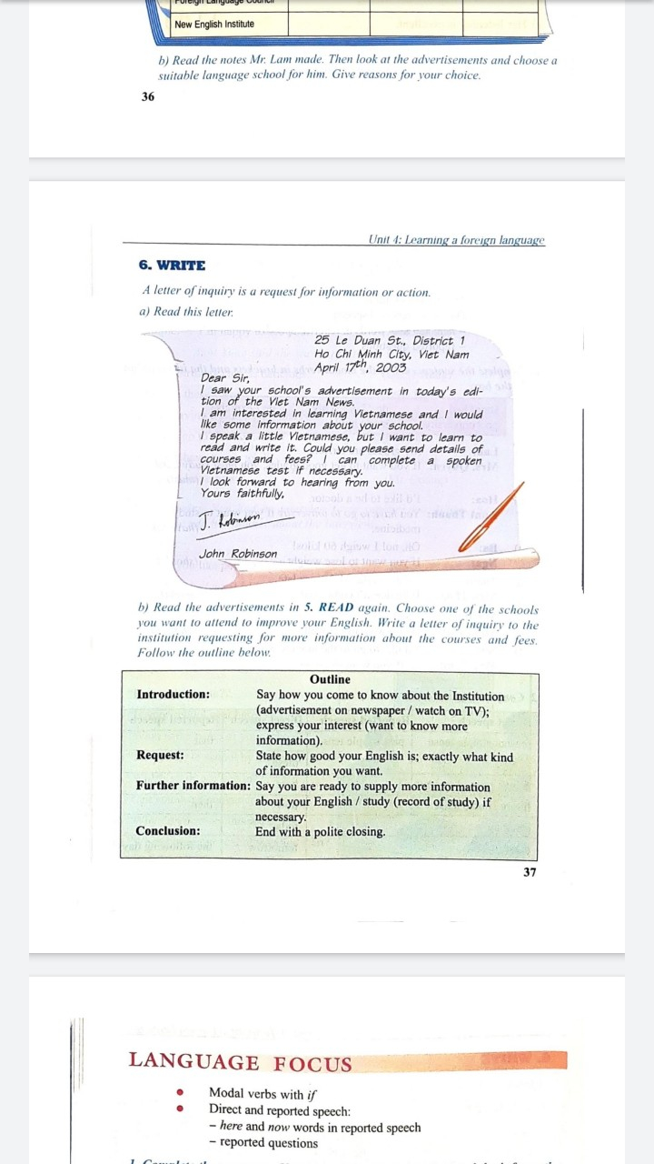

Slide 12

25 Le Duan Street, District 1
Ho Chi Minh City, Viet Nam
April 17th, 2003
Dear Sir,
I saw your school’s advertisement in today’s edition of the Viet Nam news.
I am interested in learning Vietnamese and I would like some information about your school.
I speak a little Vietnamese, but I want to learn to read and write it. Could you please send details of courses and fees? I can complete a spoken Vietnamese test if necessary.
I look forward to hearing from you.
Yours faithfully,
John Robinson

Slide 14

Read Mr. Robinson’s letter and complete the table.
Section | Content
Introduction | I saw your school’s ……………………. in today’s edition of …………………
Request | I can …………………………… I want to ………………………........ I would like to know more about ……………. of courses and ……….
Further information | I can complete ………………………… …………………..
Conclusion | I look forward to …………………. ………………….......
advertisement
the Viet Nam News.
speak a little Vietnamese.
learn to read and write it.
details
fees
a spoken Vietnamese
test.
hearing from you.
Yours faithfully,

Slide 15
Read the advertisements in lesson: Read. Choose one of the schools you want to attend to improve your English. Write a letter of inquiry to the institution requesting for more information about the courses and fees.
Note:
The format of a letter of inquiry
Introduction
Request
Further information
Conclusion
* Polite closing:
Yours faithfully,
Yours sincerely,
Faithfully/ Sincerely yours,

Slide 16
267 Quang Trung Street, Ward 11,
Go Vap District, Ho Chi Minh City.
October 21st, 2021.
Dear Mrs. Smith,
I saw the advertisement of your school on TV last week. I am very interested in learning English and I would like some more information about your Institute.
I can speak a little English , but I read it very slowly and my writing is bad. So I want to improve my reading and writing. Could you please send details of English courses and fees for beginners? I can complete a spoken English test if necessary.
I look forward to hearing from you.
Yours sincerely,
Nguyen Van Nam

Slide 17
HOMEWORK
Write the letter in your exercise notebook again.
Prepare Unit 4 (cont.): Language Focus (pages 38-39)

Slide 18


